Slide 1
Deleting and Updating Records in MySQL using PHP

Slide 2
Summary of the previous lecture
Retrieving data from MySQL using PHP
CONNECTIONS: login functionality

Slide 3
Outline
Deleting records in MySQL using PHP
Updating records in MySQL using PHP

Slide 4
1. Deleting record in MySQL using PHP
Connection with database
Delete the record

Slide 5
1.1 Connection with database
<?php
mysql_connect(‘localhost’,’root’,’’) or die(“error in connection”);
mysql_select_db(‘testdatabase’) or die(“error in selection”);
?>

Slide 6
1.2 Delete the record
Delete SQL instruction:
DELETE FROM table-name
WHERE condition
DELETE FROM users
WHERE user_Id =5
DELETE FROM users
WHERE user_Id >5

Slide 7
1.2 Delete the record…
<?php
include(‘connection.php’);
$sql=“DELETE FROM users
WHERE user_Id=5”;
mysql_query($sql);
?>

Slide 8
1.3 Example
Display data from database in a table
Add actions column
In each record, add a delete button
When delete button in clicked, delete that record

Slide 9
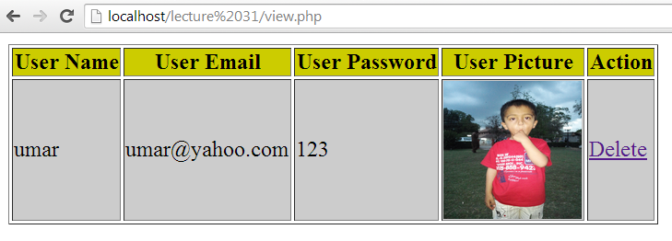
1.3 Example…
Delete

Slide 10
1.3 Example…
<?php
Connection with database
Select data
<table border=‘1’>
<tr>
<th> User Name</th>
<th> User Email</th>
<th> User Password</th>
<th> User Picture</th>
<th> Actions </th>
</tr>

Slide 11
1.3 Example…
<?php
while($rows = mysql_fetch_array($result))
{
?>
<tr>
<td> <?php echo $row[1]; ?> </td>
<td> <?php echo $row[2]; ?> </td>
<td> <?php echo $row[3]; ?> </td>
<td> <img src= “<?php echo $row[4]; ?>”> </td>
<td><a href=“delet.php?id=<?php echo $rows[0];?>”>Delete</a>
</tr>
<?php } ?>
</table>

Slide 12
1.3 Example…
<a href=“delet.php?id=<?php echo $rows[0];?>”> Delete</a>
Id name
Link starts
Page name
Assigning the id of current record
End of link
Link text

Slide 13
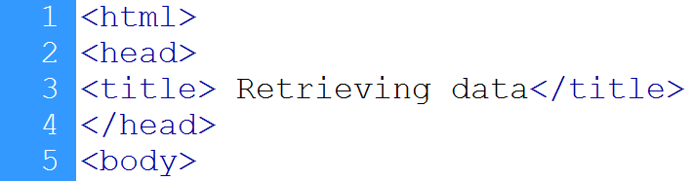

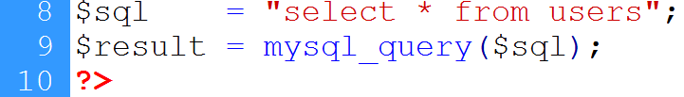
1.3 Example…
Starts HTML page
Connection to database
Selecting data

Slide 14
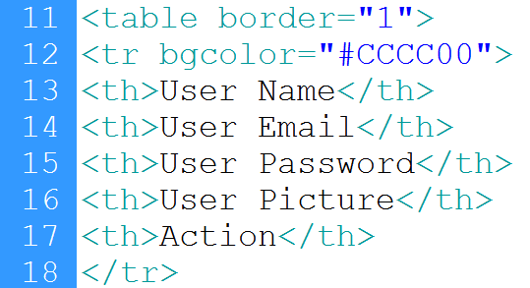
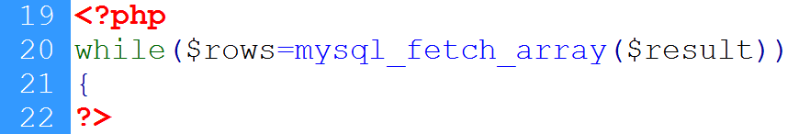
1.3 Example…
Heading row
Loop starts

Slide 15
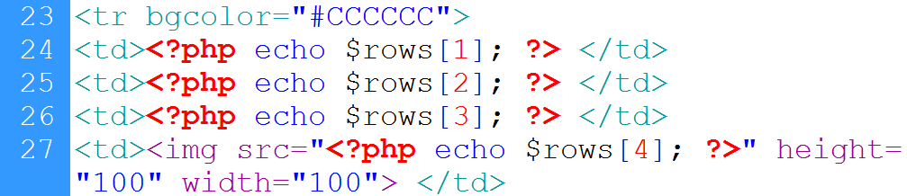
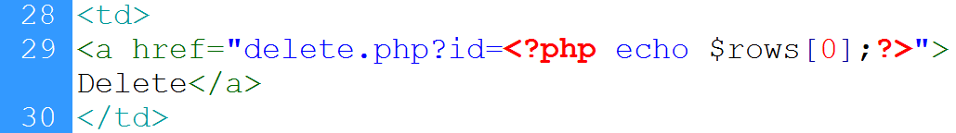
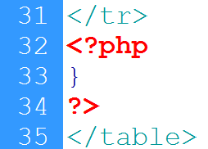
1.3 Example…
Writing user’s record
Link to the delete.php
Ends loop

Slide 16



1.3 Example…
Getting record id
DB connection
Delete instruction
Executing instruction

Slide 17
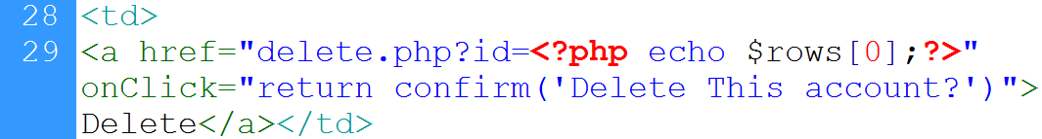
1.3 Example…
Confirmation before delete:
Link to page
On-click event
Confirm box

Slide 18
2. Updating records in MySQL using PHP
Connection with database
Update the record

Slide 19
2. Updating records in MySQL using PHP…
Update SQL instruction:
UPDATE table-name
SET column-names = values
WHERE condition
UPDATE users
SET user_Name = ‘Ali’,
user_Email = ‘ali@yahoo.com’,
user_Password=‘123’
WHERE user_Id=1

Slide 20
2. Updating records in MySQL using PHP…
<?php
Include(‘connection.php’);
$sql =“UPDATE users
SET user_Name = ‘Ali’,
user_Email = ‘ali@yahoo.com’,
user_Password=‘123
Where user_Id=1’’;
mysql_query($sql);
?>

Slide 21
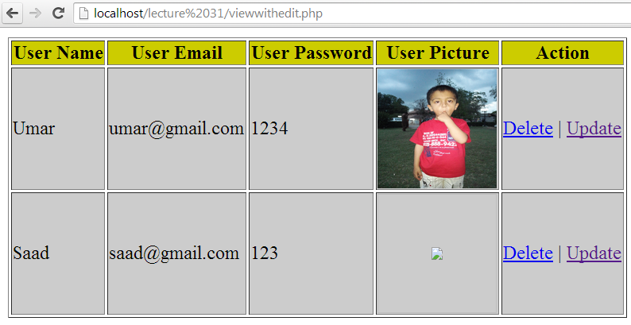
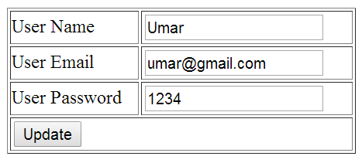
2.1 Example
Selects update
Form with previous values

Slide 22
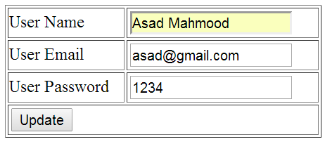
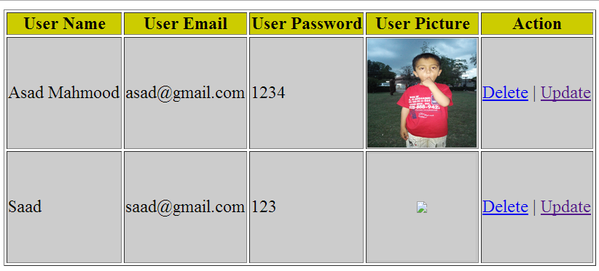
2.1 Example…
Values are updated
Updated record

Slide 23
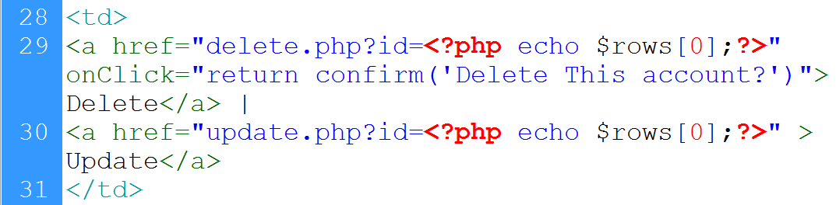
2.1 Example…
View page:
Link to update.php, record id is passed with link

Slide 24
2.1 Example…
Get id of the record
Connect to database
Retrieve record from database against the id
Start form
Set retrieved values as value of the input fields

Slide 25
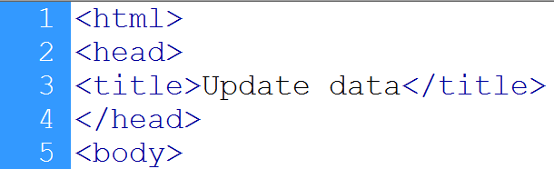

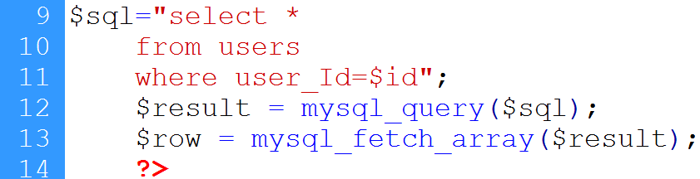
2.1 Example…
HTML page start
Gets record’s id
DB connection
Data selection
Query execution
Record is retrieved

Slide 26
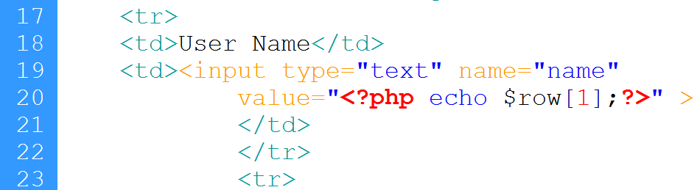
2.1 Example…
Form starts
Table starts
Id is sent as hidden value
label
Value is set to user’s current name

Slide 27
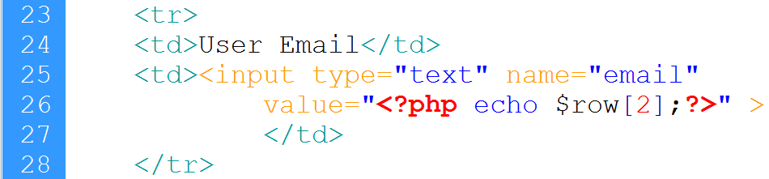
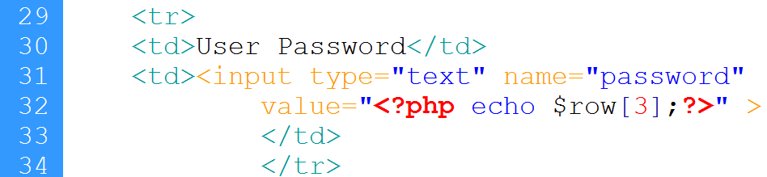
2.1 Example…
Email
password

Slide 28
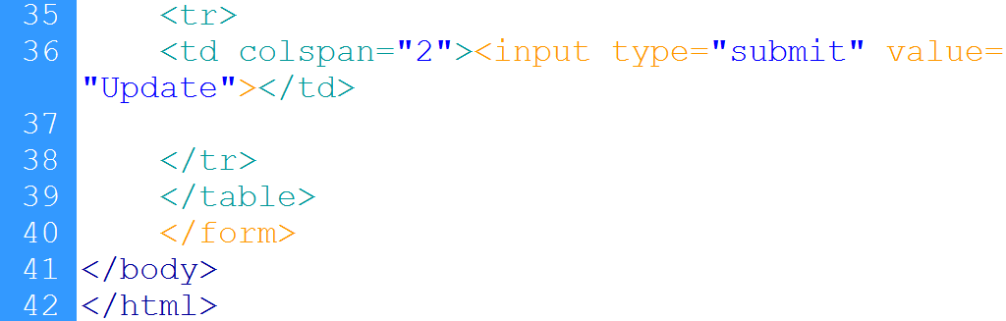
2.1 Example…
Submit button

Slide 29
2.1 Example…
Up_action.php page:
Retrieve users input
Connect with database
Execute update instruction
Redirect to view page

Slide 30
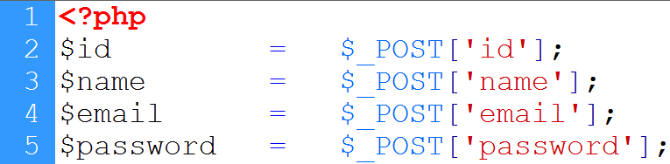
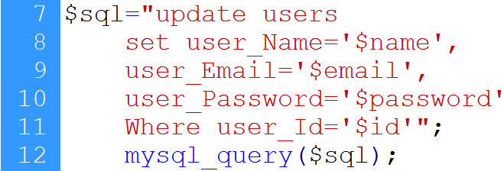
2.1 Example…
User’s input
Connection to database
Update instruction
redirection

Slide 31
Summary
Deleting record from tables in MySQL using PHP
Updating record in MySQL using PHP

Slide 32
References
Chapter 30, “Beginning PHP and MySQL” by W. Jason Gilmore, Apress publisher, 4th edition; 2010, ISBN-13 (electronic): 978-1-4302-3115-8.

